Slide 1
New ABAP SYNTAX TIPS & EXPRESSIONS

Slide 2
Instead of catch cx_sy_itab_line_not_found:
data(gs_booking) = value #( gt_booking[ 1 ] optional ).

Slide 3
Quick data display:
cl_demo_output=>write( gt_booking ). cl_demo_output=>write( gs_booking ). cl_demo_output=>display( ).

Slide 4
Instead of describe table…lines:
data(gv_lines) = lines( gt_booking ).
Read last row:
data(gs_booking1) = value #( gt_booking[ gv_lines ] optional ).

Slide 5
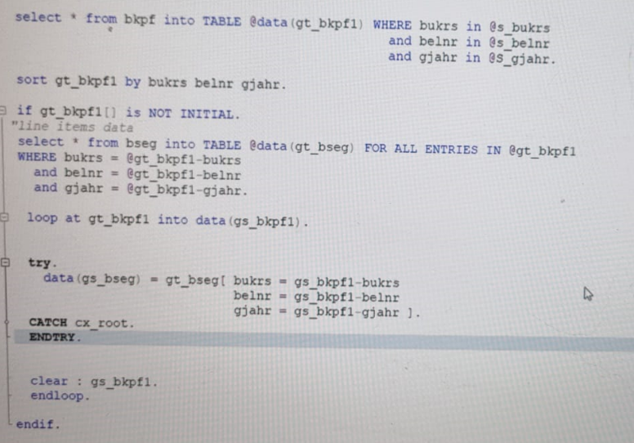
Using read tables:

Slide 6
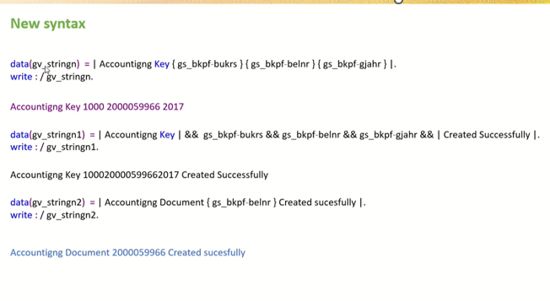
New concatenate syntax:

Slide 7
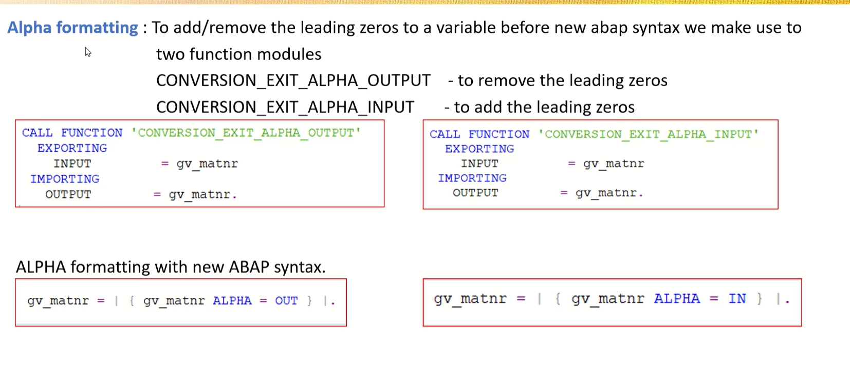
FORMATTING

Slide 8
